Slide 1
IS-623 Project Chandigarh LLT
By-
Rohin Mehta
Smit Ajmera
Yi Xie
Shivani Jain
Karan Patel

Slide 2
Content
Planning Phase- Deliverable 1
Analysis Phase- Deliverable 2
Design Phase- Deliverable 3
Q&A

Slide 3
Planning Phase- Deliverable 1

Slide 4
Introduction of the Company
Chandigarh Trading LLT is an independently owned private business located in Jersey City, United States. They are well distinguished in this business and have setup their field of work in New Jersey from the past 15 years.
The business is owned by Mr. Ashwini Bansal who manages Six employees. Managers in the organization report directly to him for store operations. The main business of the company can be divided into two parts: Sales and Service. The business comprises of selling mobile phones, sim cards, mobile covers, mobile chargers, earphones and other mobile accessories.

Slide 5
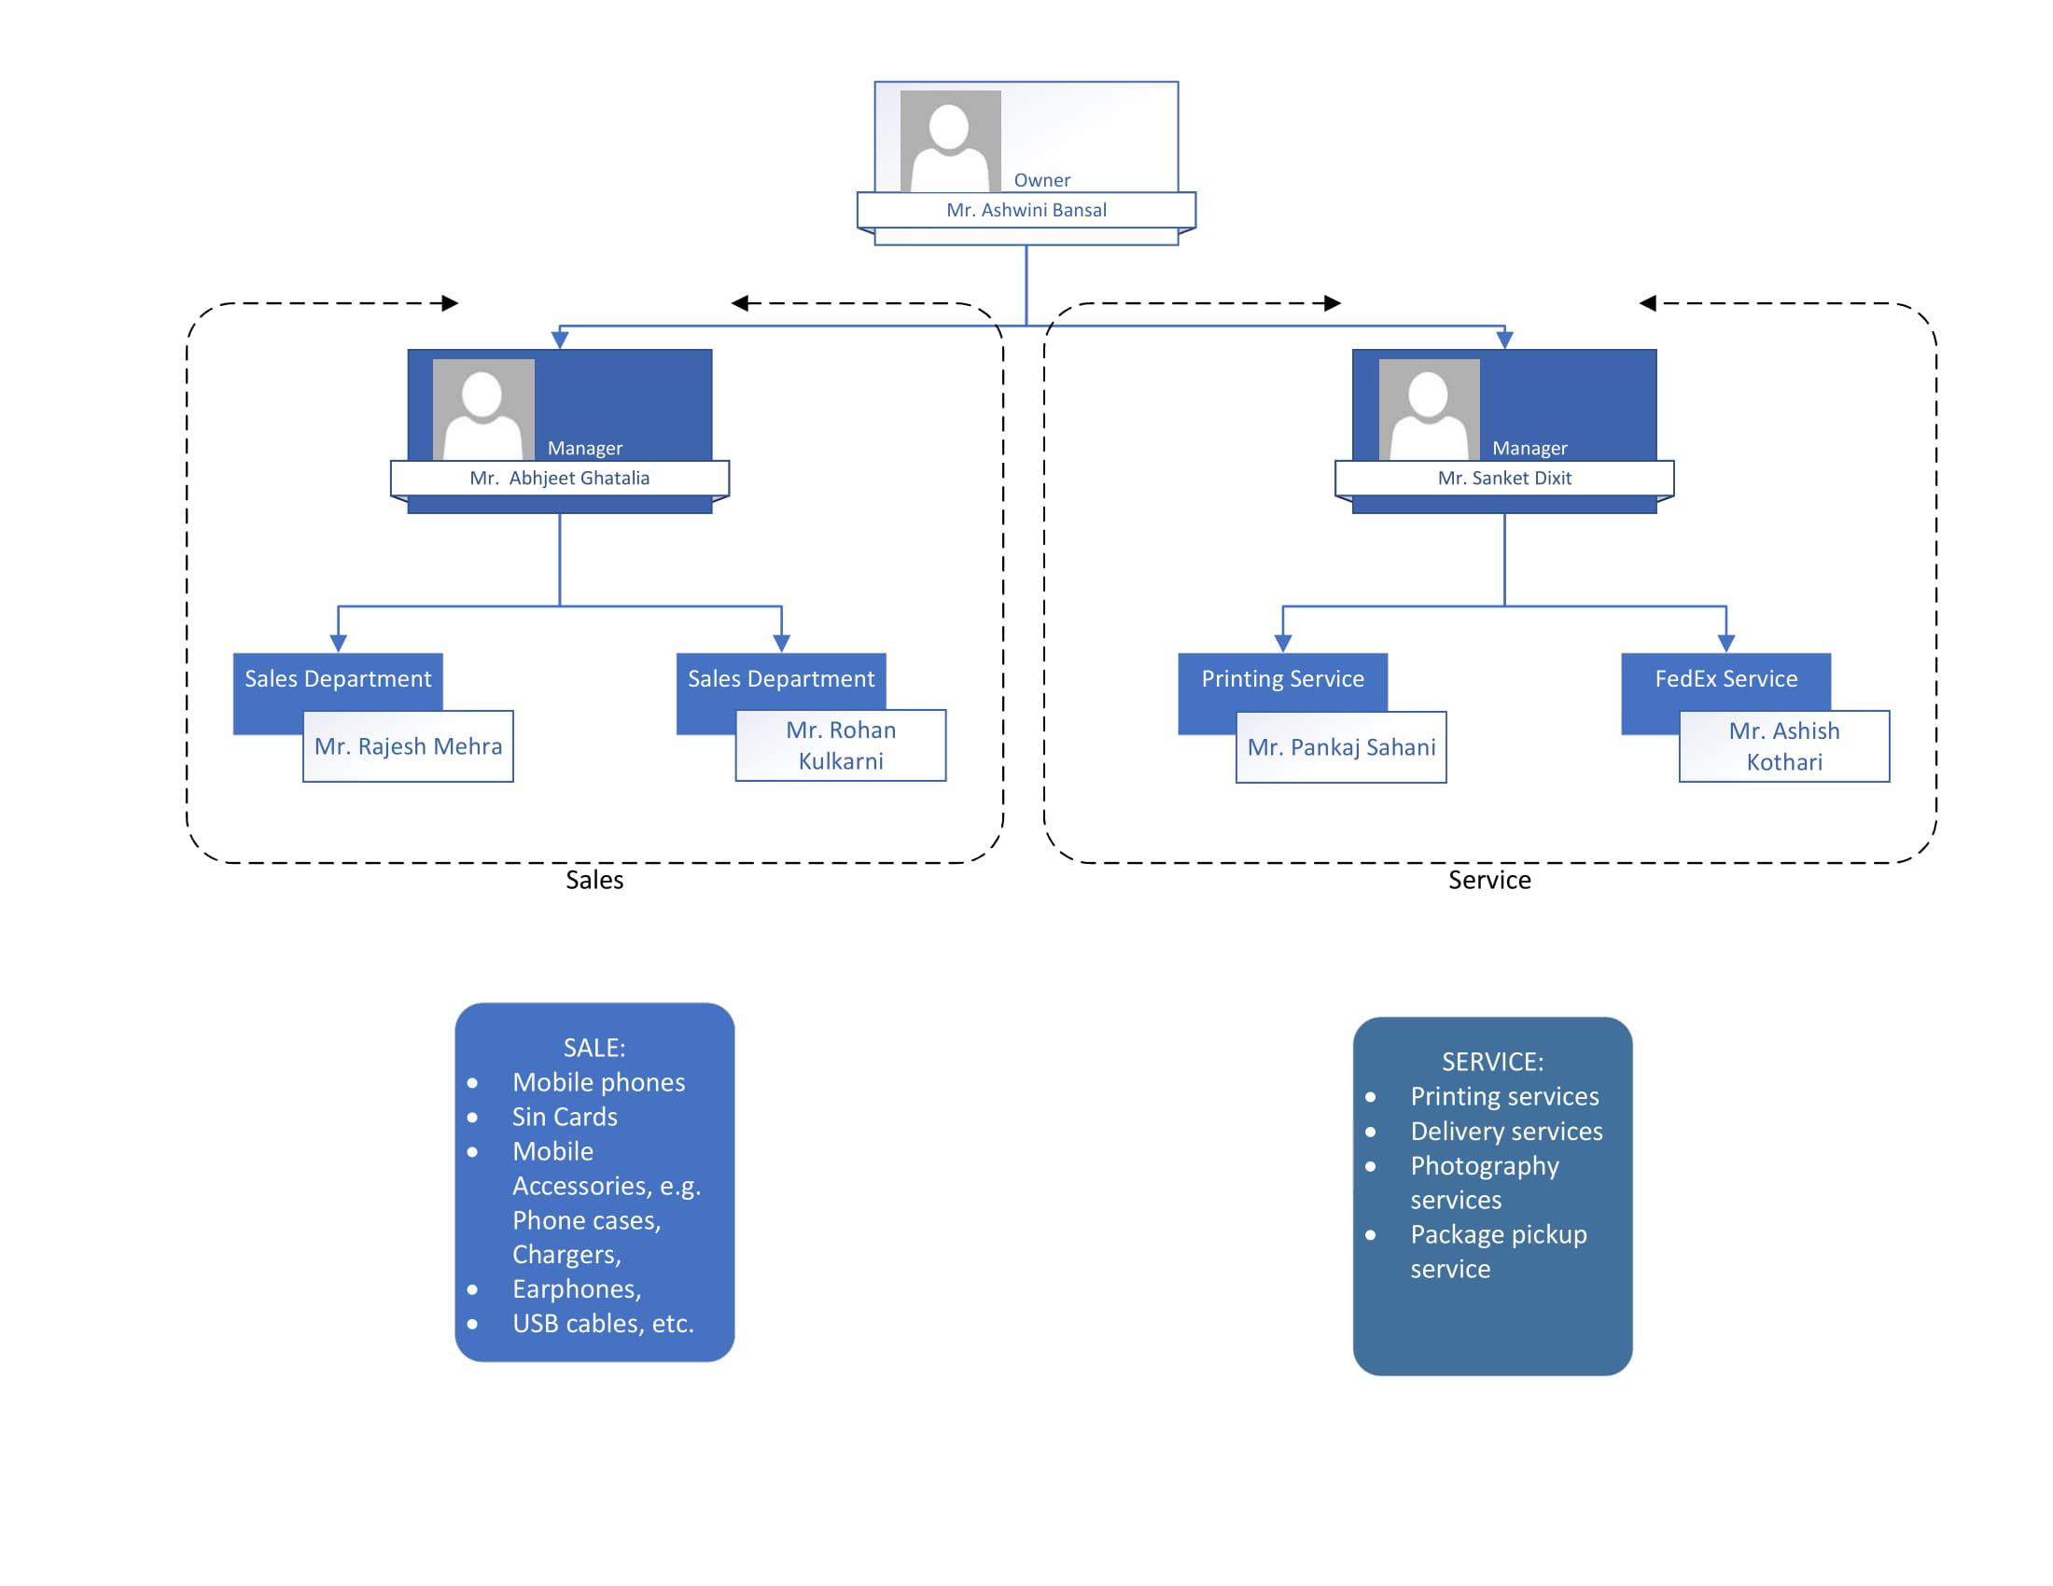
Organizational Chart

Slide 6
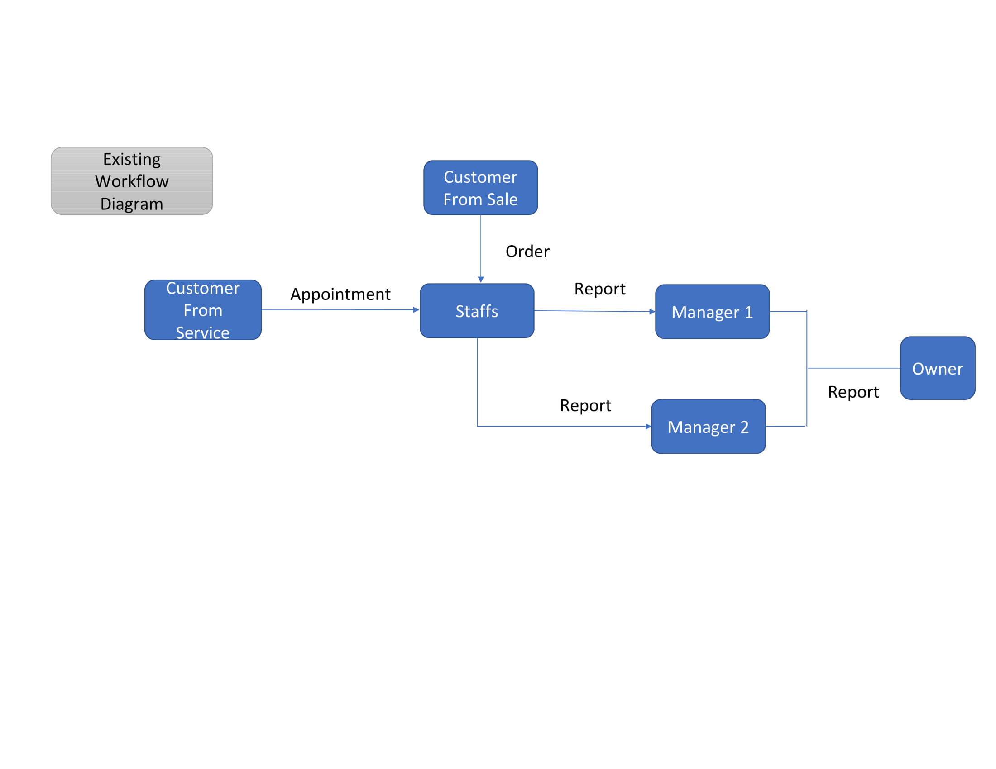
Existing System

Slide 7
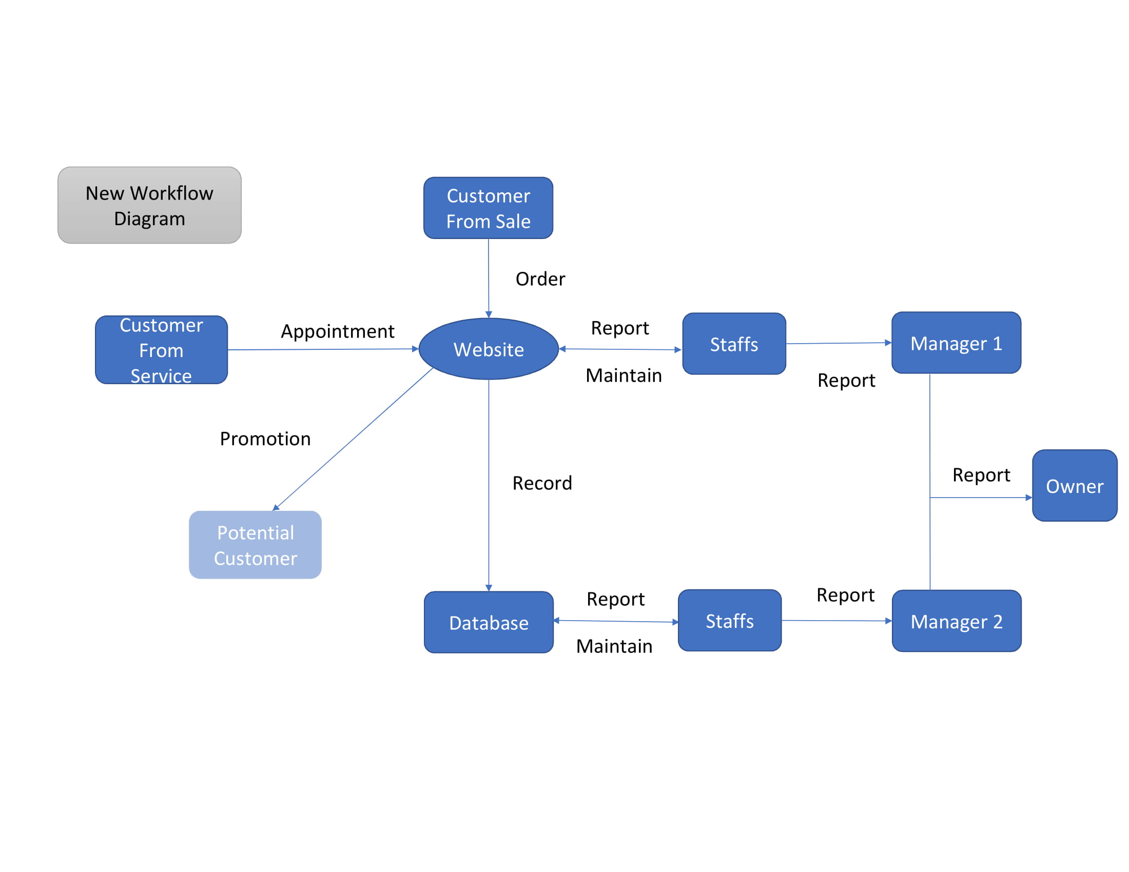
Proposed System

Slide 8
Purpose of the new system
The existing system is traditional hardly uses any technology, the new system will allow the business to grow.
Few drawbacks were discovered in the existing system, which are handled by the new system.

Slide 9
System Request Document
Mr. Ashwini Bansal- Project Sponsor
Business Need
Business Requirements
Business values
Special Issues or Constraints

Slide 10
Feasibility Analysis- Technical Feasibility
Familiarity with the business applications
Lack of Familiarity with the technology
Project Size
Compatibility with the existing system

Slide 11
Economic Feasibility
Development Cost
Operating Cost
Intangible Benefits
Tangible Benefits

Slide 12
Organizational Feasibility
Strategic Alignment
Evaluation of the effect on stakeholders:-
Project Champion
Organizational and Management Support
System User

Slide 13
Risk Assessment
Risk 1: The website is prone to phishing and malware attacks from all over the internet.
Likelihood of risk: Moderate, as the security of the website will be implemented step by step and in a proper manner. The website will be completely secured, and various measures will be taken to ensure the protection of the user’s data by using encryption process.
Potential impact on the project: If the website is compromised, then the entire system or business will be in danger. The user’s data, entire process and the business value of the organization is affected.
Ways to address this risk: The website should have a secured database. Loopholes in the codes must be prevented through some key measures. The website should not take any file or document type of input from any user. Various measures should be taken from time-to-time to keep the website updated.

Slide 14
Risk Assessment
Risk 2: The faults and glitches on the website that can affect the process of ordering or payment
Likelihood of risk: Not likely, as the entire website will be developed without any loopholes in the code. Along with that the website will be tested several times before it runs for the business.
Potential impact on the project: The faults and glitches on the web are common issues and it can either lose the trust of the customers or act as a deterrent. Secondly it will have a tremendous negative impact on the business value of the organization.
Ways to address this risk: Testing should be done in every stage of the development. The code of the website should be clear and flawless. The risk should be determined at the earlier stages and proper counter-measures should be implemented. The backup team should be available in case of any issues faced on the website.

Slide 15
Risk Assessment
Risk 3: The Website may fail to perform efficiently due to overload.
Likelihood of risk: Moderate , as the number of users visiting the website can affect the performance of the website, it can cause serious trouble to the customers.
Potential impact on the project: If the website fails to perform under high traffic, the customers will be forced to leave the website and it will have a negative impact on the business of the organization.
Ways to address this risk: The website should be tested meticulously. The maintenance of the website should be done regularly. The website should be equipped with enough servers to handle huge number of users at a single point of time. Updates should be deployed regularly. Estimation should be used to identify and predict the number of users and accordingly different servers must be employed.

Slide 16
Analysis Phase- Deliverable 2

Slide 17
Functional Requirements
Creating and Accessing the user’s Account
Searching Product and its Details
Buying and Returning/Cancelling the product
Customer Service

Slide 18
Non-Functional Requirements
Operational Requirements
Performance Requirements
Security Requirements
Cultural and Political Requirements

Slide 19
Use-Case analysis
Creation of an Account
Searching and Adding products to the Cart
Placing Order
Cancelling Order
Processing Payment

Slide 20
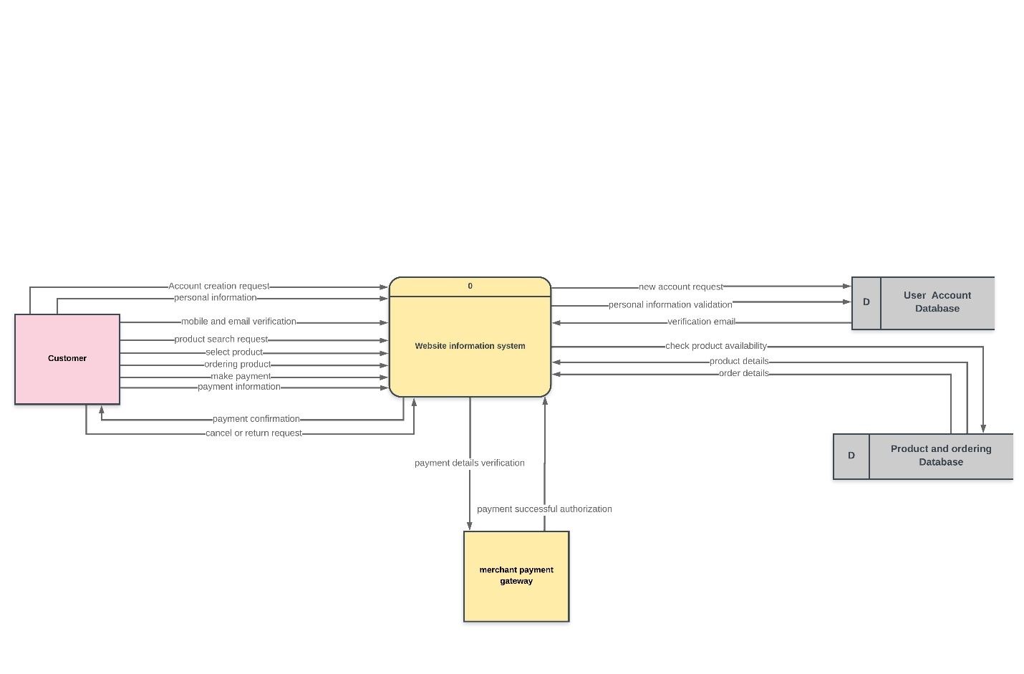
Process Models- Data-Flow Diagrams
Context Diagram

Slide 21
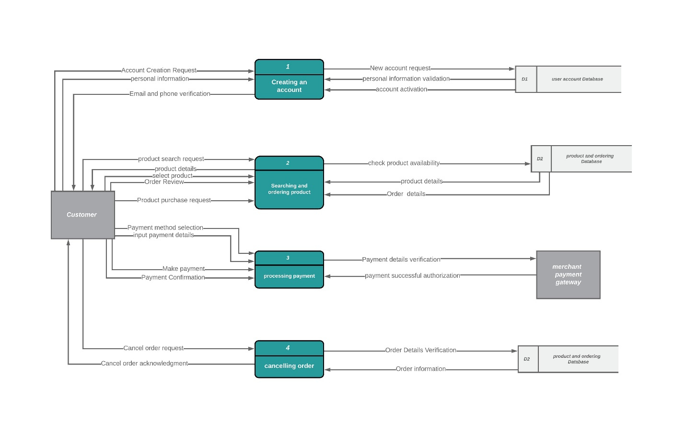
Process Models- Data-Flow Diagrams
Level 0

Slide 22
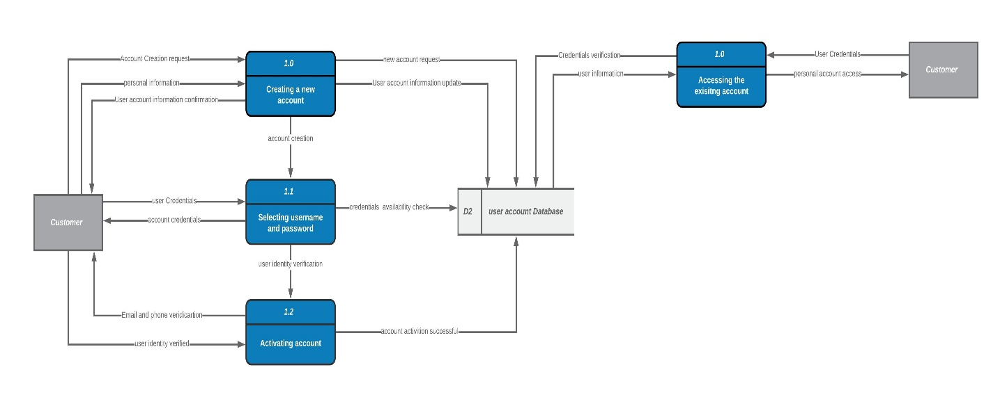
Level 1- Creation of an account

Slide 23
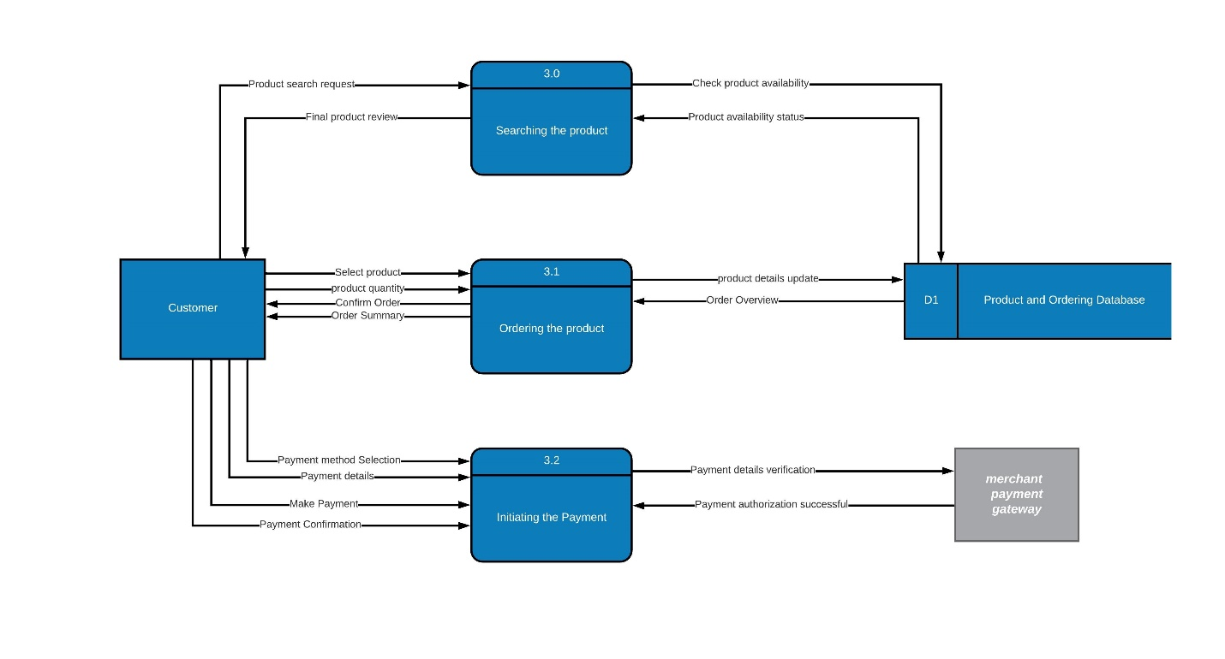
Level 1- Searching and Ordering a product

Slide 24
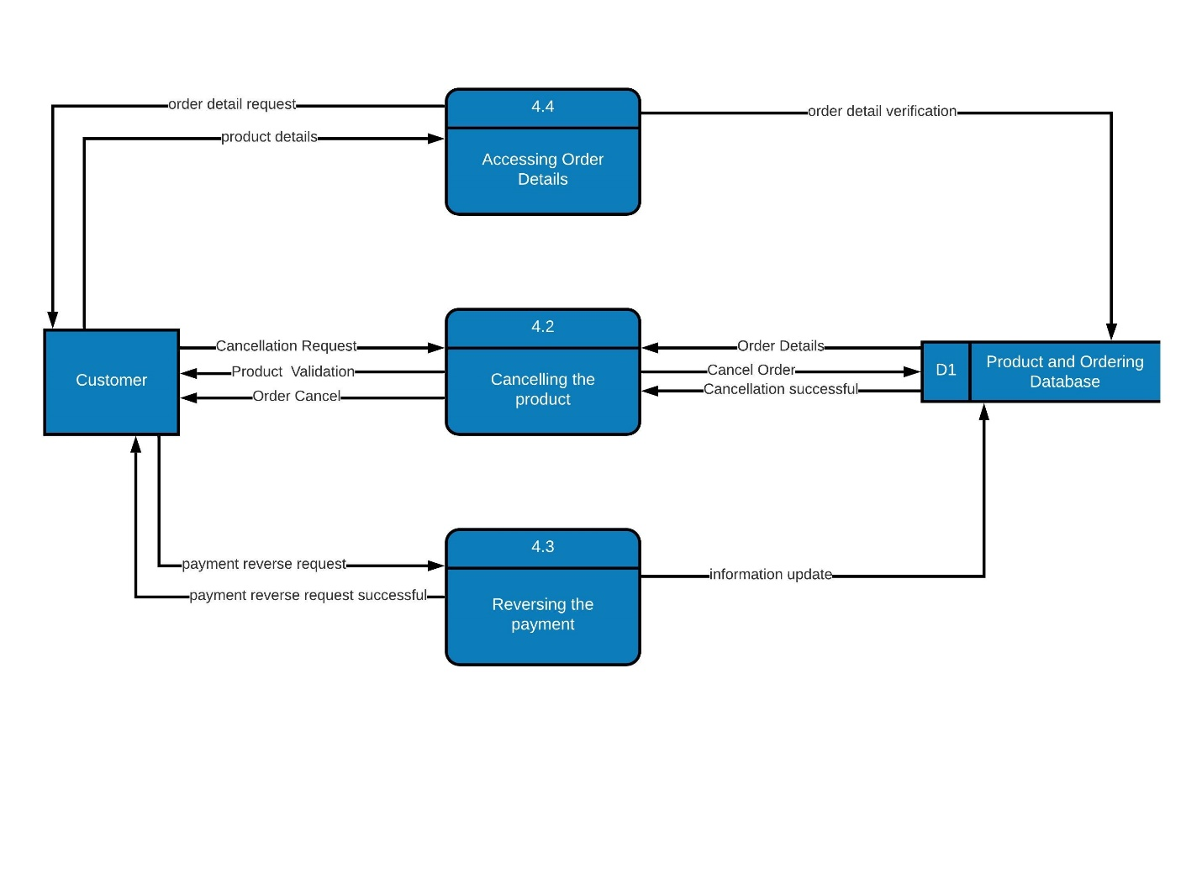
Level 1- Cancelling Order

Slide 25
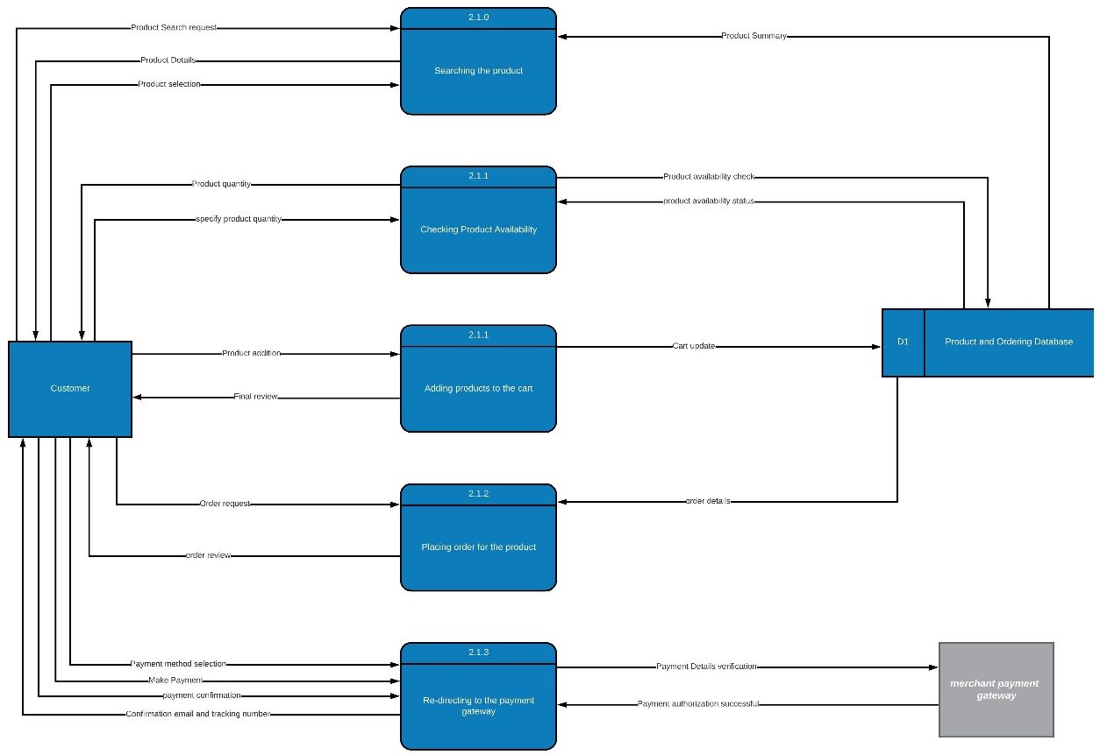
Level 2- Searching and Ordering a Product

Slide 26
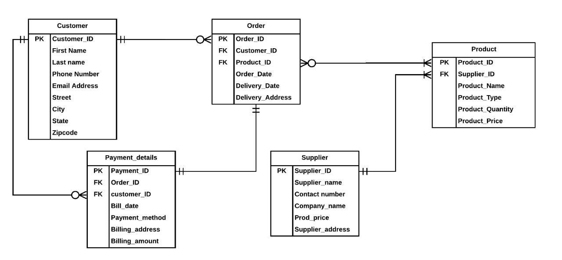
Entity-Relationship Diagram ERD

Slide 27
Design Phase- Deliverable 3

Slide 28
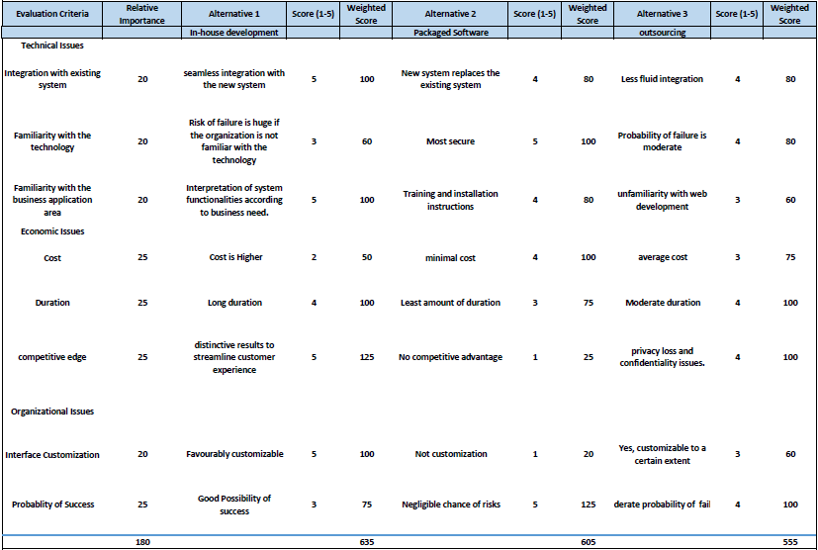
Alternative Matrix

Slide 29
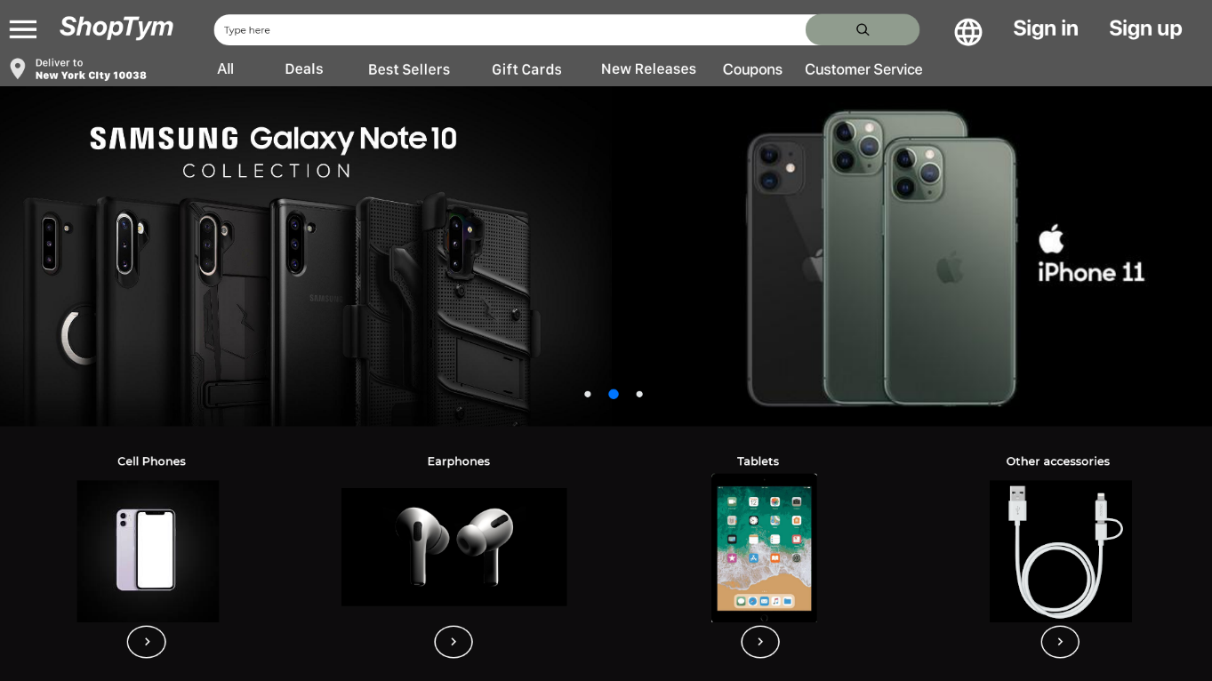
System-Interface Design

Slide 30
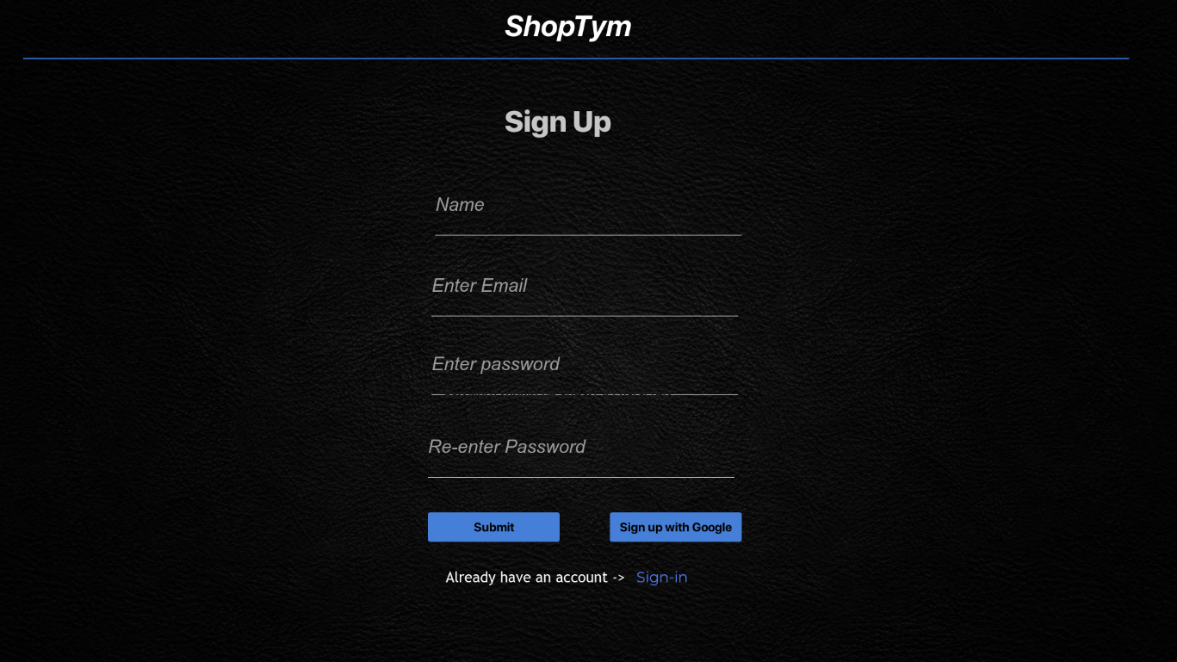
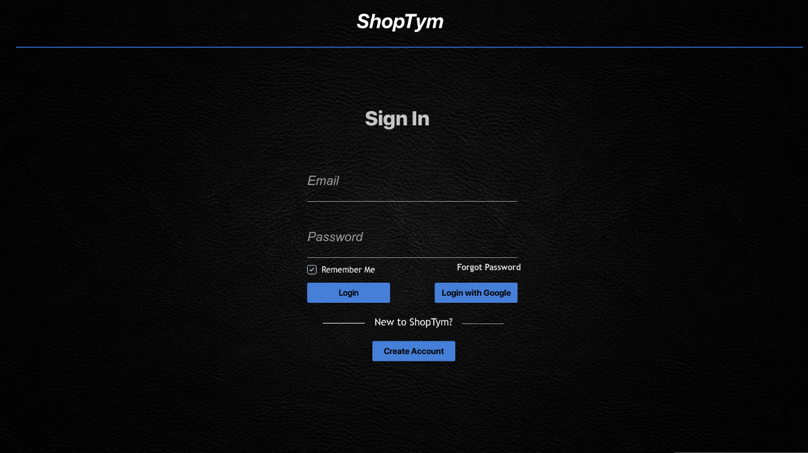
System-Interface Design

Slide 31
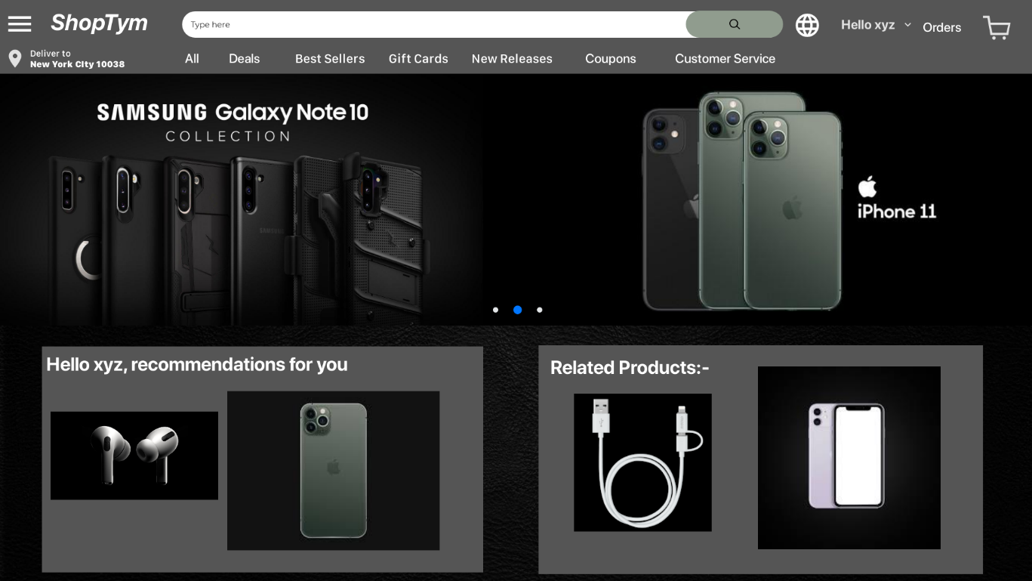
System-Interface Design

Slide 32
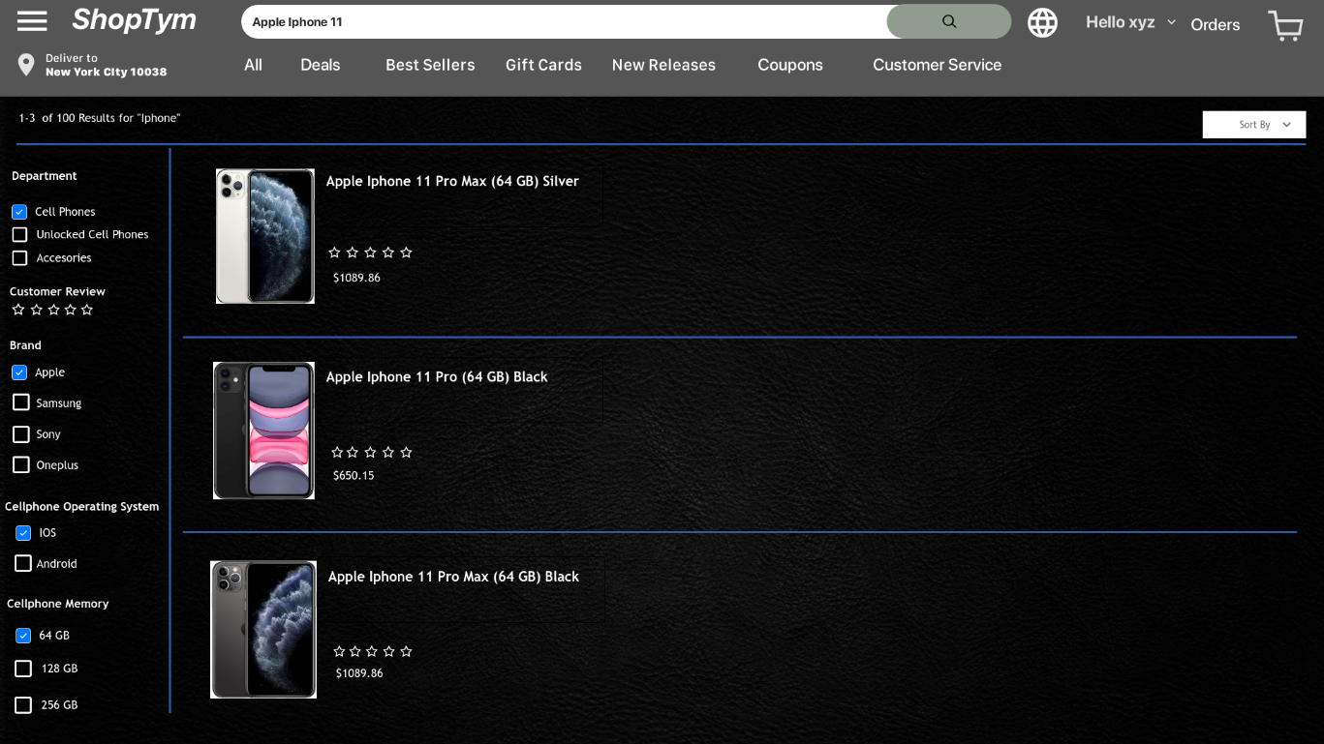
System-Interface Design

Slide 33
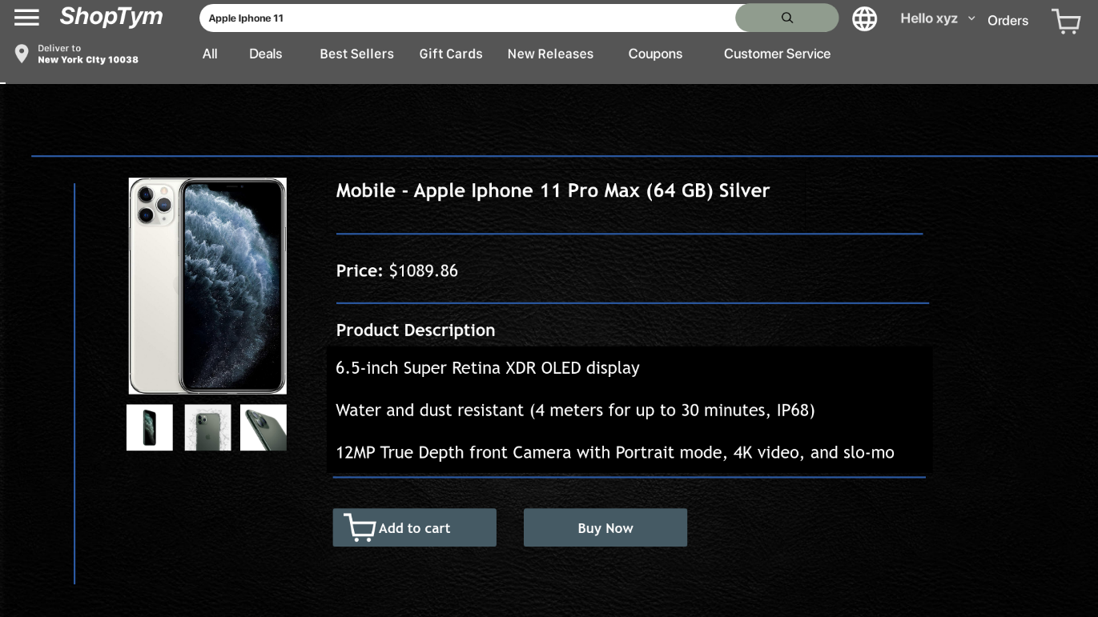
System-Interface Design

Slide 34
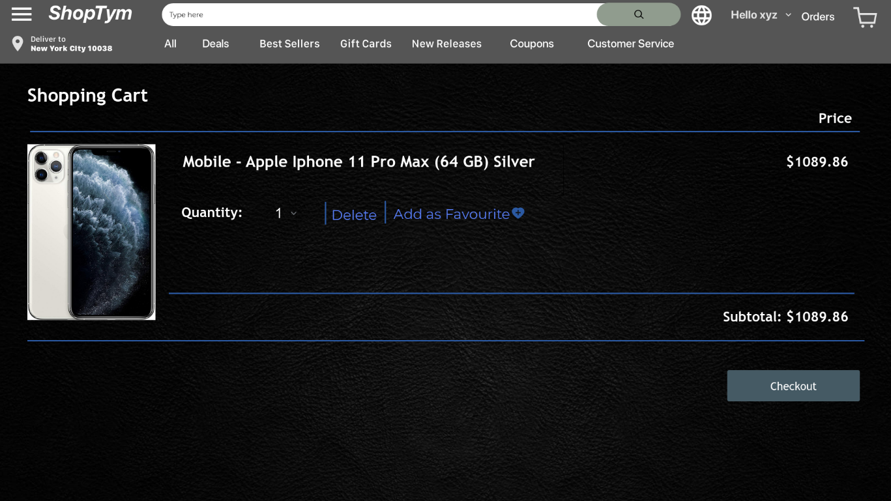
System-Interface Design

Slide 35
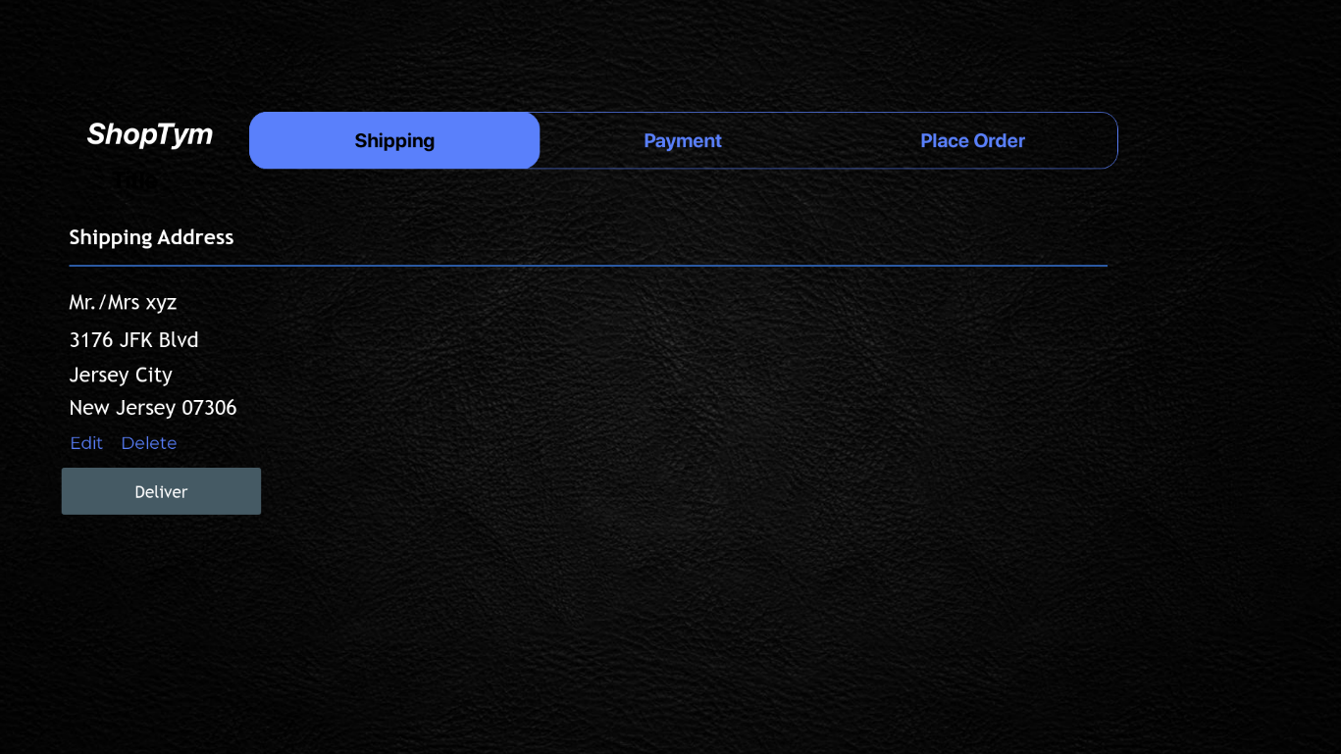
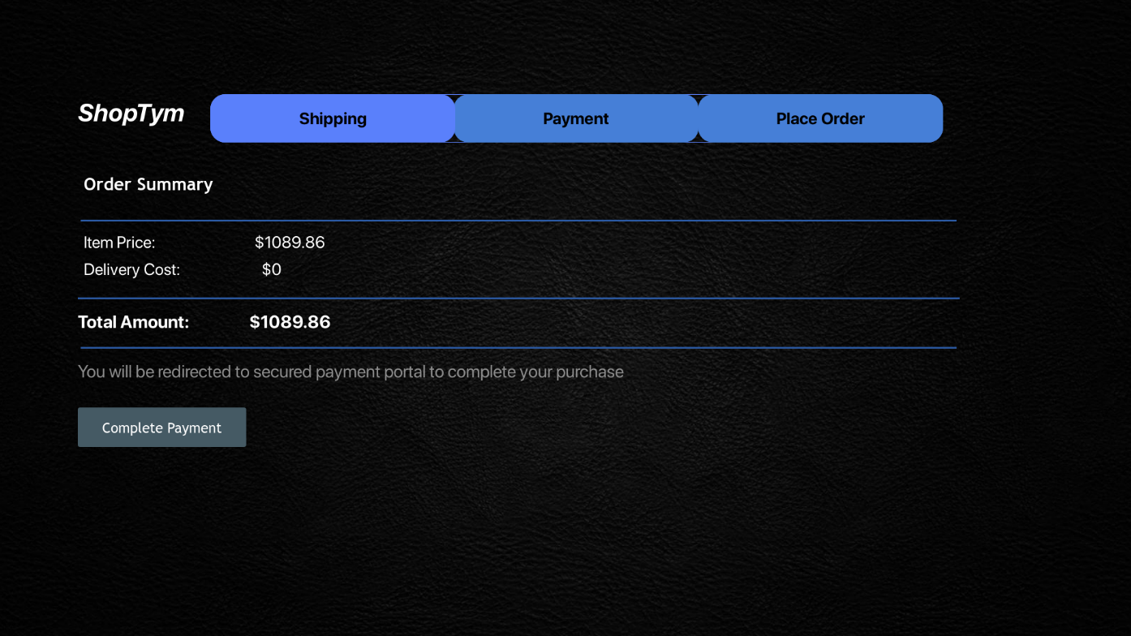
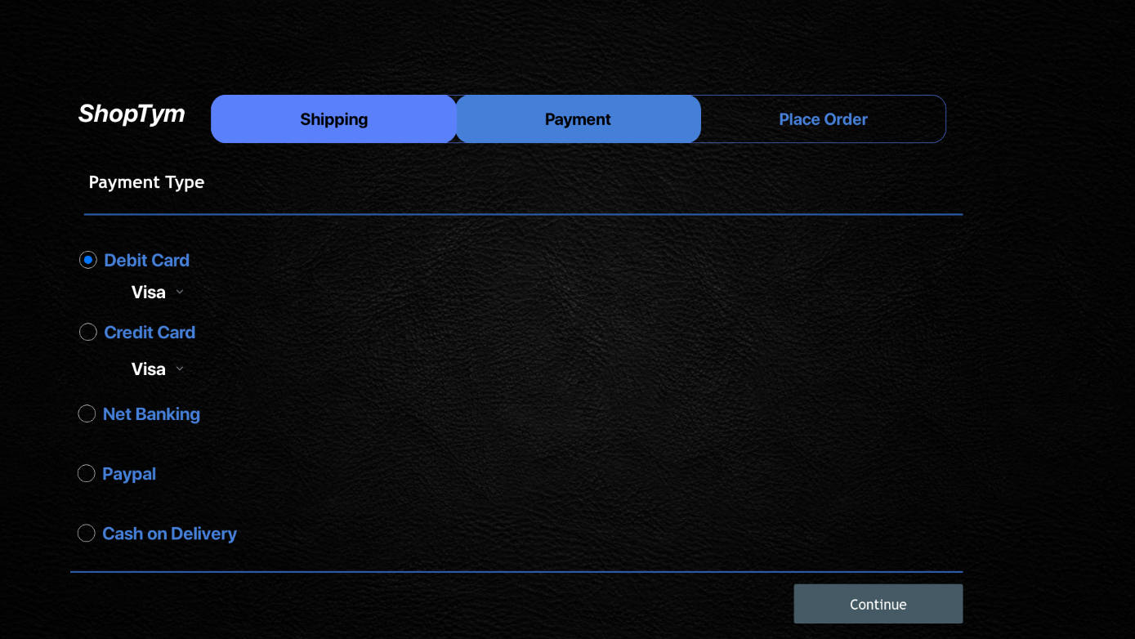
System-Interface Design

Slide 36
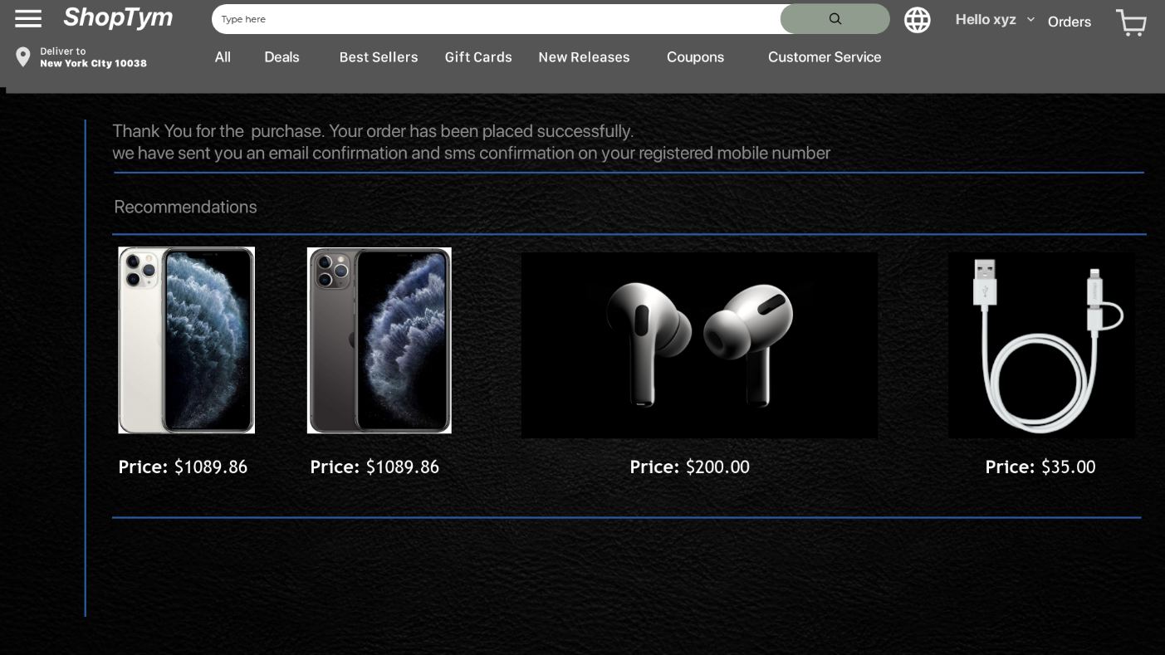
System-Interface Design

Slide 37
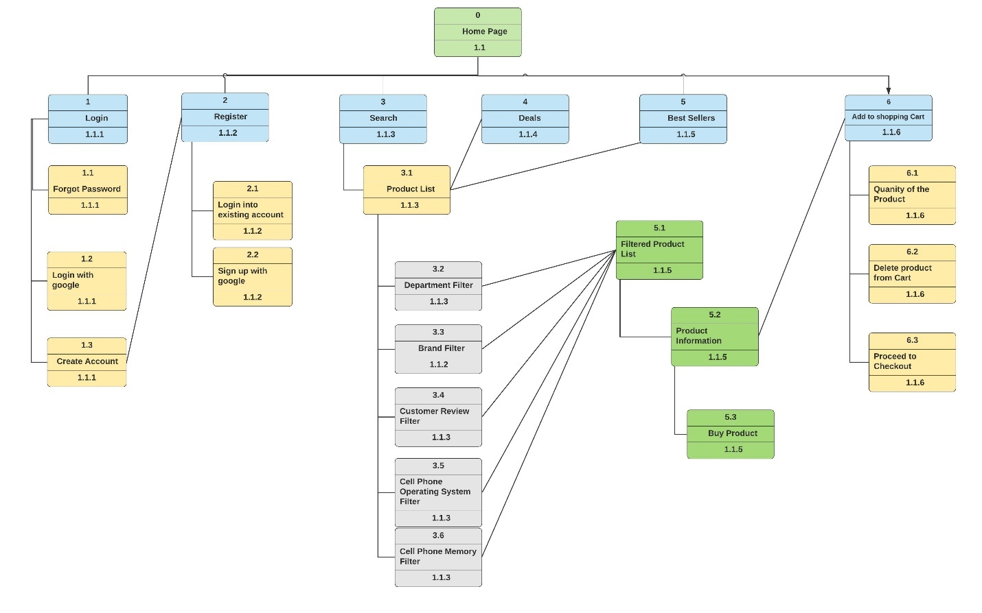
System Interface Structure Diagram

Slide 38
Site-Map
Account | Customer Service | Services | Deals
Sign In | Contact us | Purchase Products | Featured by Department
Sign Up | Track Orders | Search Products | Featured by Price
Edit personal Info | Cancel orders | Shipping Products | Featured by Customer Review
Recommendations | Refunds | Returning Products | Featured by Availability
Memberships | Customer Feedback | Filter Products | Featured by Discounts
Subscriptions | FAQs | Add Favorites | Featured by specifications
Password Recovery | Error Report | Payment Methods | Recommended products

Slide 39
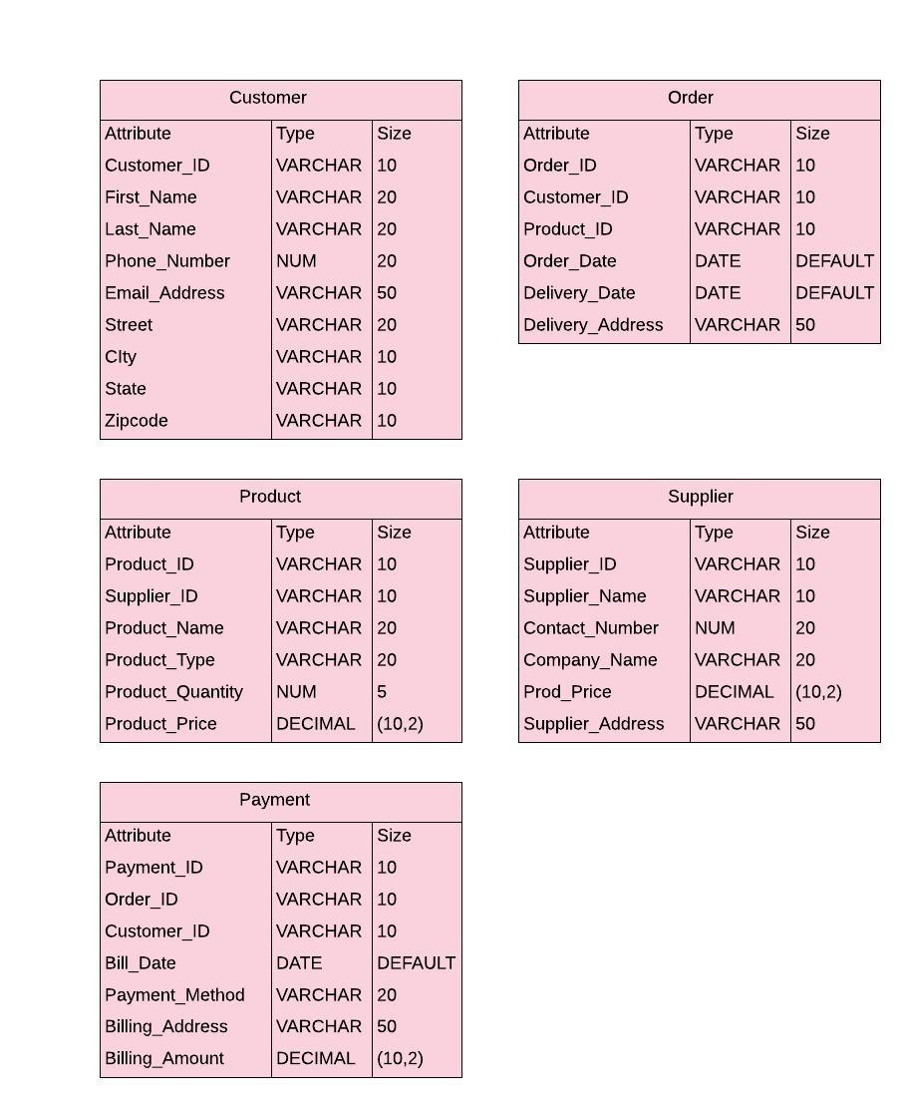
File-Data Specifications

Slide 40
Thank-You

